Slide 1
Machine Learning Project
Austin James

Slide 2
Problem
Can we predict future SAT scores looking at the last 45 years of scores?

Slide 3
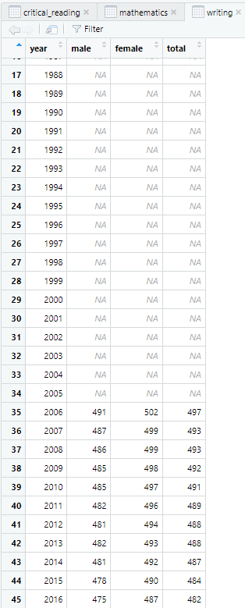
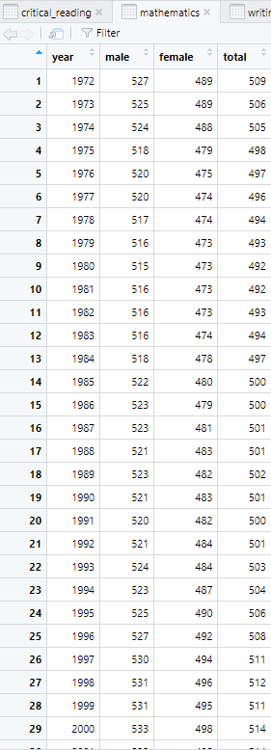
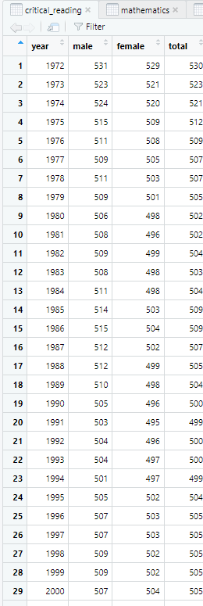
Data Collection

Slide 4
What model do we use
We are looking to predict the future with past supervised data, so the best option is a regression model.

Slide 5
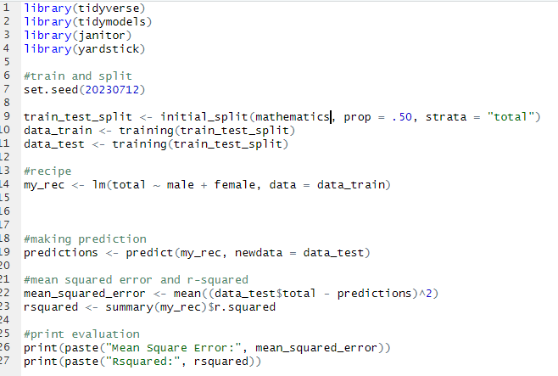
Mathematical model

Slide 6
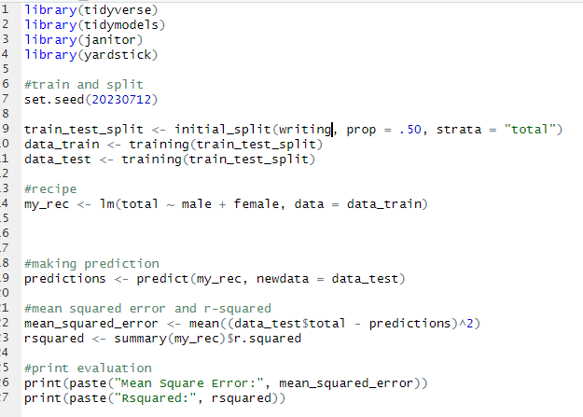
Writing Model

Slide 7
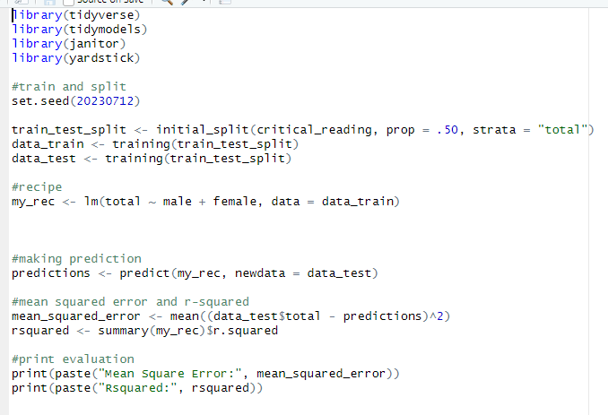
Critical Reading Model

Slide 8

Mathematics Model Results

Slide 9

Critical Reading Model Results

Slide 10

Writing Model Results

Slide 11
Positive/Negative of Model
Positive
Accurate at predicting total scores
Negative
Not enough data to split and could have impacted the accuracy of data prediction
Not enough variables in the data set that could also impact the accuracy of prediction

Slide 12

Thank You

